Slide 1
Align Train the Trainer Workshop

Slide 2
Registered Entity Requesting Access and Pre-Launch Provisioning

Slide 3
Setting up PCC Accounts for Align
All Align users MUST have an ERO Portal Account
Set up ERO Portal Account:
Navigate to https://eroportal.nerc.net.
Select “Register” in the upper left-hand corner.
Complete the registration form and click “Submit.”
Verify ERO Portal Account:
Navigate to https://eroportal.nerc.net.
Select “Sign In” in the upper left-hand corner.
Enter your credentials to confirm access to ERO Portal.
Prior to 3/31/2021 go-live, NERC ensured all PCCs with ERO Portal Accounts were set up as an Align Registered Entity Submitter and SEL Submitter and Entity Administrator and this person is responsible for approving Align access requests

Slide 4
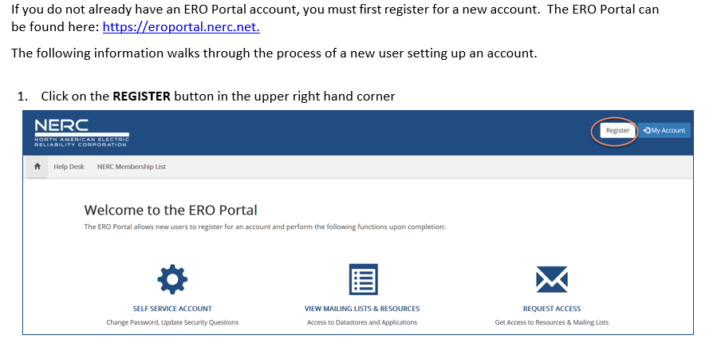
Setting up an ERO Portal Account Start a New Registration

Slide 5
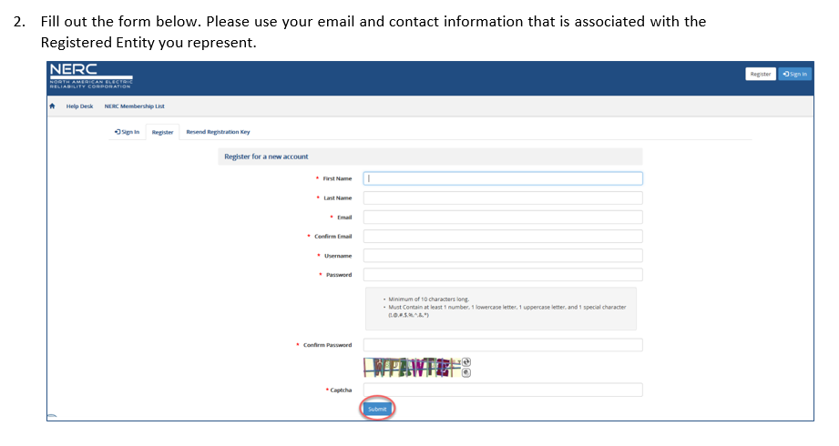
Setting up an ERO Portal Account Provide Email and Username

Slide 6
Setting up an ERO Portal Account Complete Registration

Slide 7
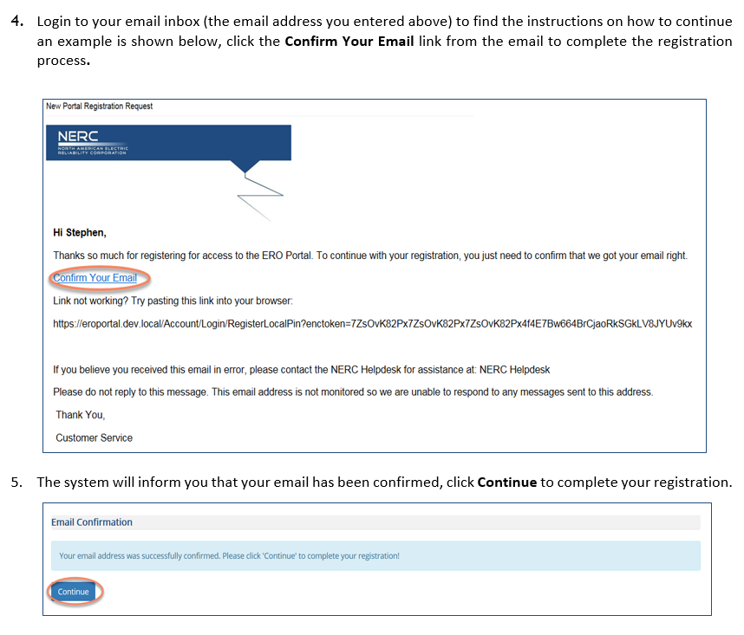
Setting up an ERO Portal Account Confirm Email Address

Slide 8
Setting up an ERO Portal Account Confirm Email Address

Slide 9
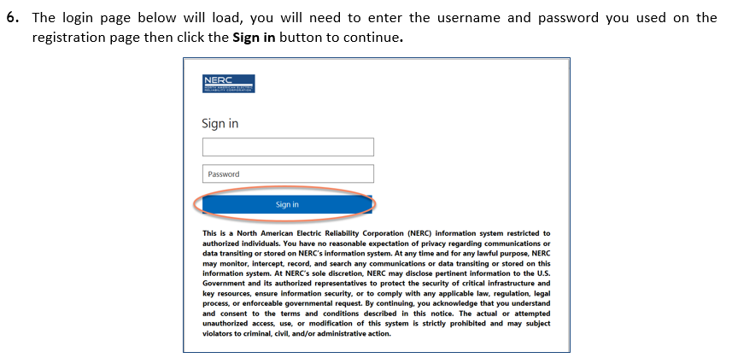
Setting up an ERO Portal Account Re-directed to Login

Slide 10
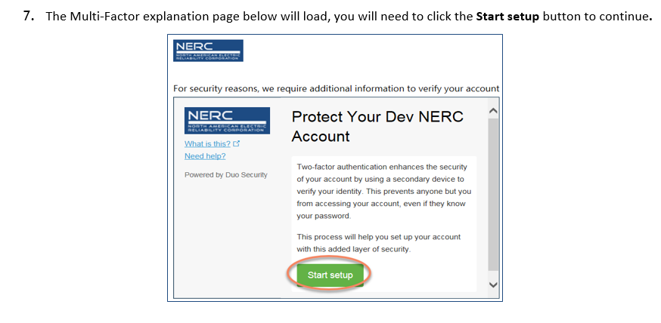
Setting up an ERO Portal Account Setup DUO

Slide 11
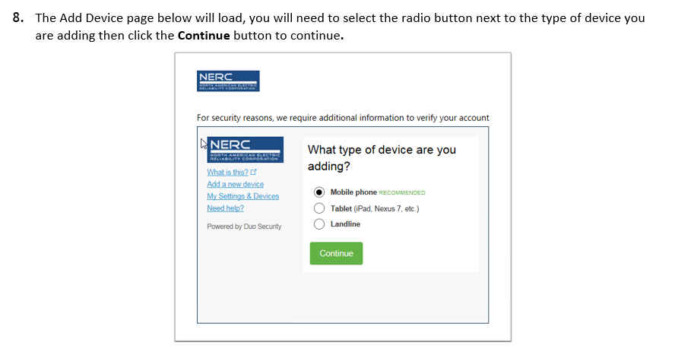
Setting up an ERO Portal Account Add Your Device

Slide 12
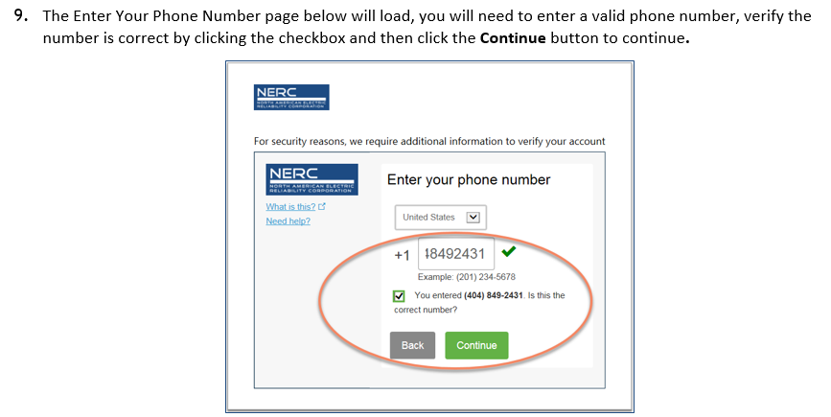
Setting up an ERO Portal Account Add Your Device

Slide 13
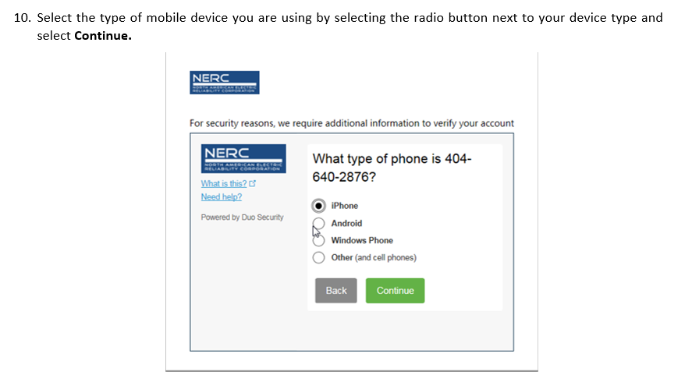
Setting up an ERO Portal Account Specify Device Type

Slide 14
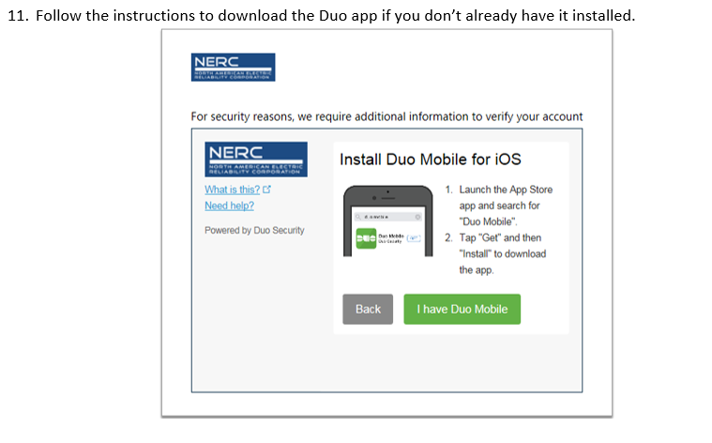
Setting up an ERO Portal Account Install DUO App

Slide 15
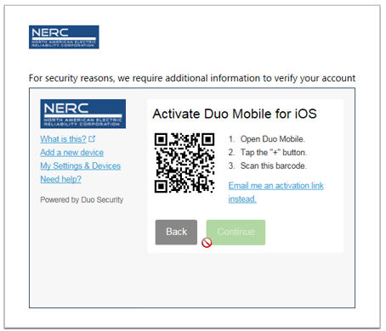
Setting up an ERO Portal Account Active DUO

Slide 16
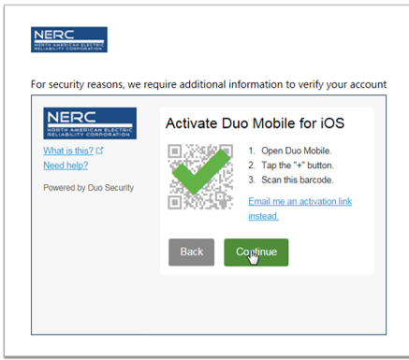
Setting up an ERO Portal Account Active DUO

Slide 17
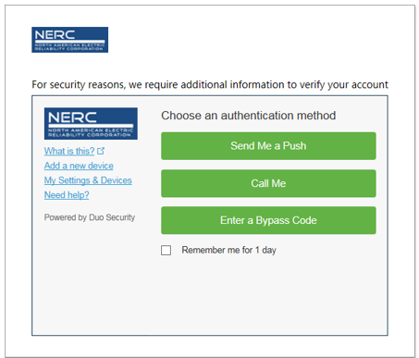
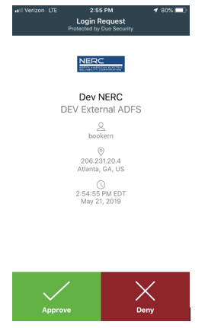
Setting up an ERO Portal Account DUO Setup is Complete

Slide 18
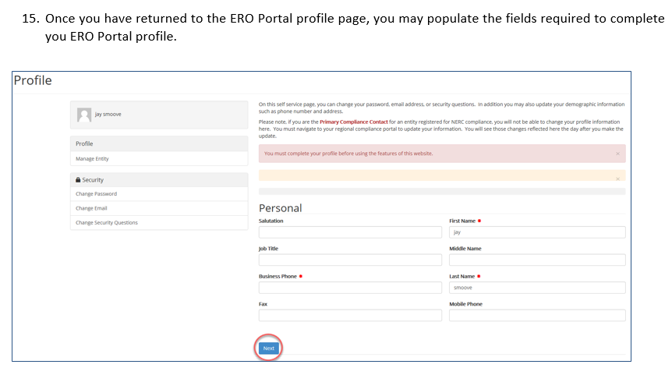
Setting up an ERO Portal Account Complete ERO Portal Profile

Slide 19
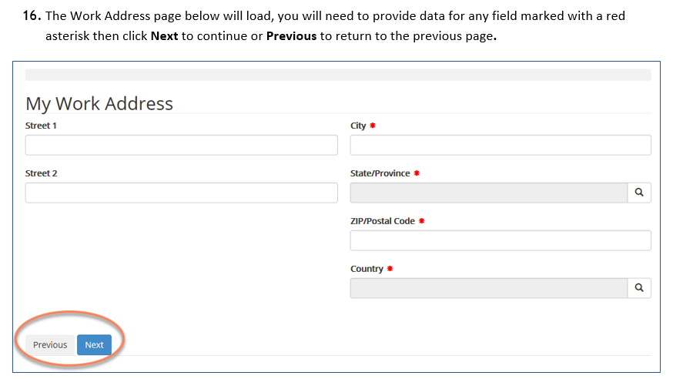
Setting up an ERO Portal Account Complete Address Section

Slide 20
Setting up an ERO Portal Account Complete Company Section

Slide 21
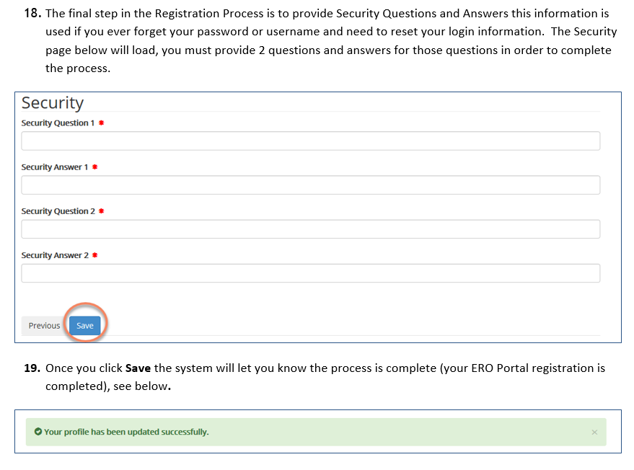
Setting up an ERO Portal Account Setup Security Questions & Answers

Slide 22
Existing User Login

Slide 23
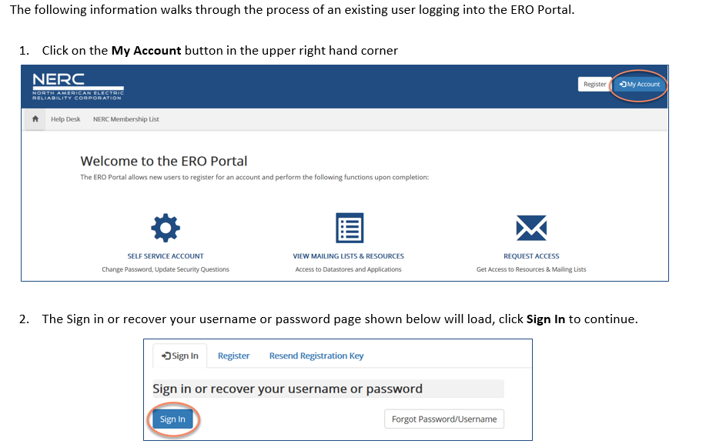
Verify ERO Portal Account Login

Slide 24
Verify ERO Portal Account External Stakeholder or NERC Staff?

Slide 25
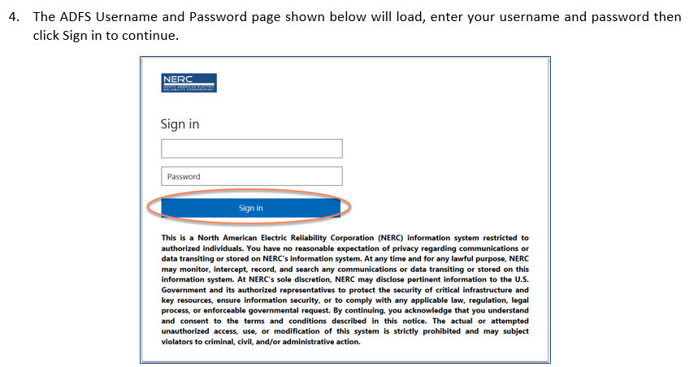
Verify ERO Portal Account Sign In

Slide 26
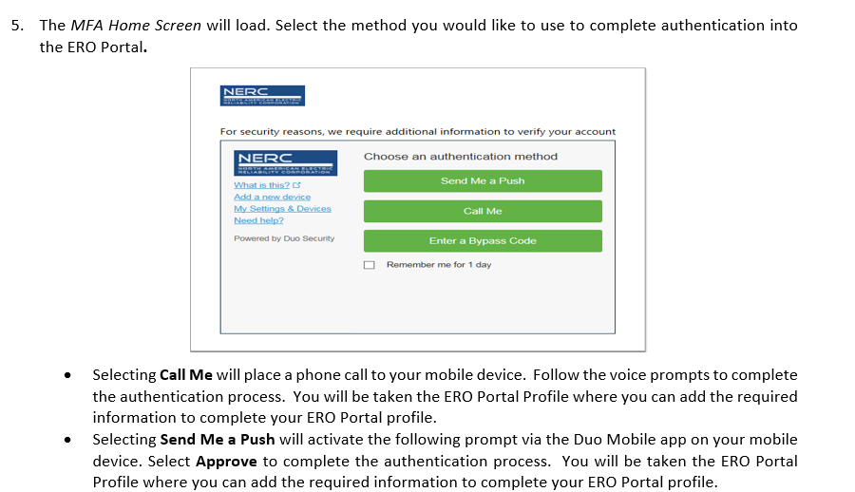
Verify ERO Portal Account DUO Authentication Prompt

Slide 27
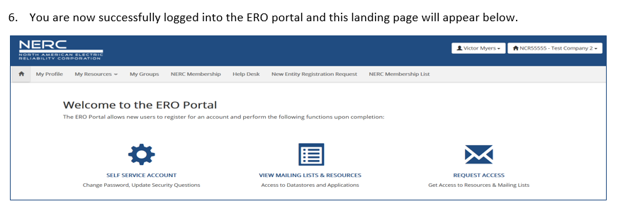
Verify ERO Portal Account Successfully Logged In

Slide 28
Requesting Align Access

Slide 29
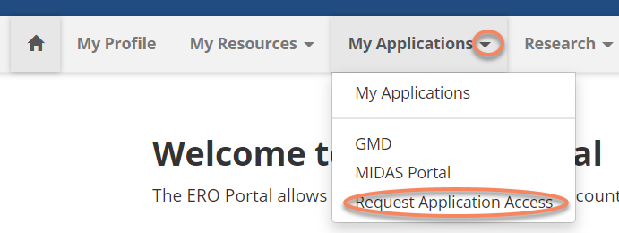
Request Application Access

Slide 30
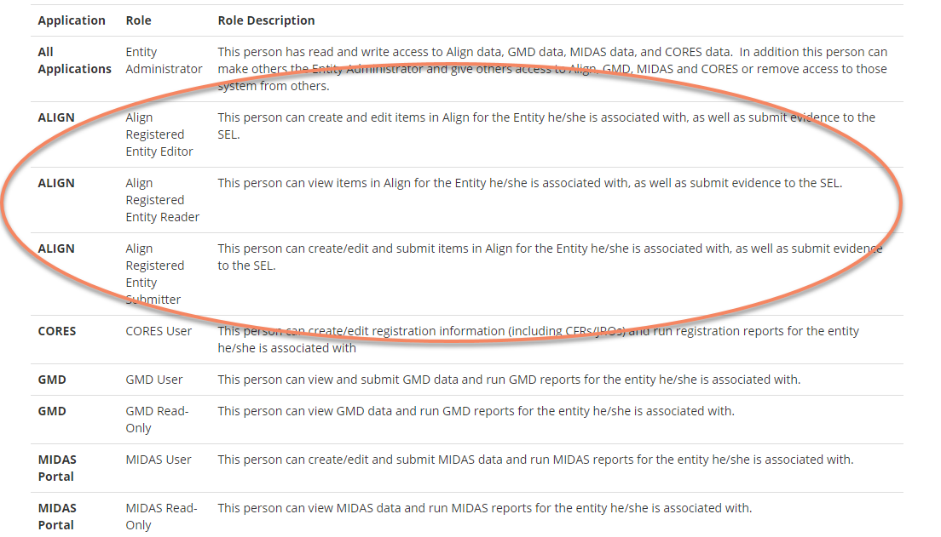
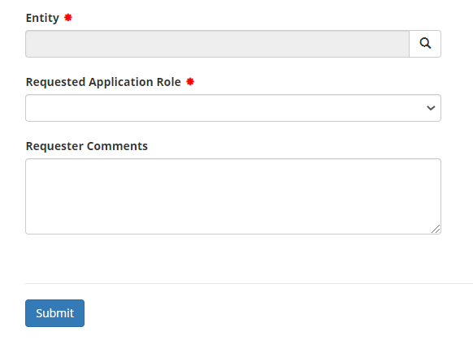
Create New Application Request Page

Slide 31
Align - Account Access
Account Access Levels
Align Registered Entity Reader
Can log into Align and see everything for their Registered Entity, but cannot make changes.
Align Registered Entity Editor
Can log into Align, see everything for their Registered Entity, and make changes, but cannot submit anything to the CEA for review or processing.
Align Registered Entity Submitter
Can log into Align, see everything for their Registered Entity, make changes, and submit things to the CEA for review or processing.

Slide 32
Select Your Entity
all entities registered with NERC for compliance purposes and non-registered entities that have a reporting obligation (MIDAS/GADS/TADS)
can only select 1 entity

Slide 33
Select Your Role
list of available roles are shown on the previous slide with a description
can only select 1 role

Slide 34
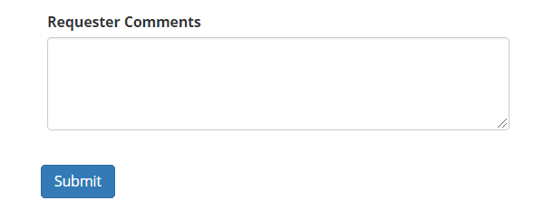
Enter Comments and Submit Request
comments are optional
click submit button to complete request
system generates an email to alert you this request has been submitted for review

Slide 35
Review and Approve Align Access Request

Slide 36
Entity Admin Navigates to Access Request
Option 1:
Option 2:

Slide 37
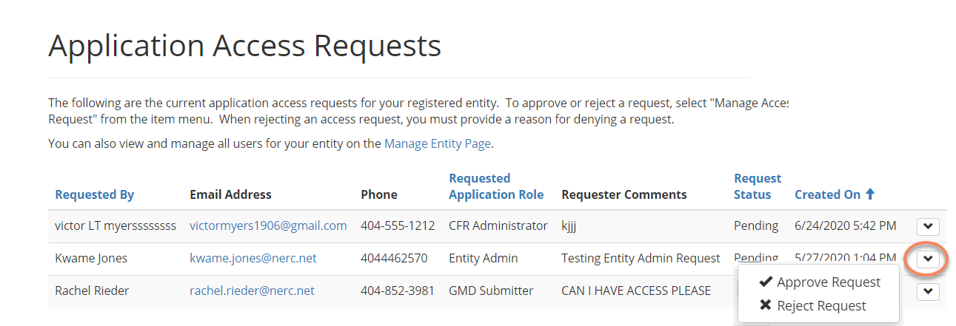
Entity Admin Manages Access Request
Landing Page – shows open request:
Option to Approve/Reject:
Once Align access is approved the system automatically grants access to SEL

Slide 38
Registered Entity User Requests Access to SEL Overview

Slide 39
Primary Compliance Contacts – Day 1
PCCs were automatically assigned access when the system went live on 3/31/2021.

Slide 40
Align Submitters – Day 2 (by end of April)
Registered Entity users that have permission to SUBMIT in Align will be given permission to UPLOAD to the SEL

Slide 41
ERO Portal Users – Day 3 (TBD)
Registered Entity admins will approve SEL access requests similar to how other ERO Enterprise Applications (CORES, GADS Wind) are approved. Any ERO Portal User will be able to request access, subject to approval by their Entity Admin.

Slide 42
Registered Entity User Requests Access to SEL Manual Processes

Slide 43
Registered Entity User Requests for SEL Access – Manual Process
For Day 1 and Day 2, there may be additional Registered Entity users that need access to the SEL.
These users will need to be added manually. The following slides describes the process

Slide 44
Registered Entity SEL Access Request Review Process
Access Approval
Region approves and routes request to NERC SEL Systems Admin.
Account Setup
NERC puts user into SEL Submitter group and routes back.
Access Verification
Region verifies user has desired access and closes Request.

Slide 45
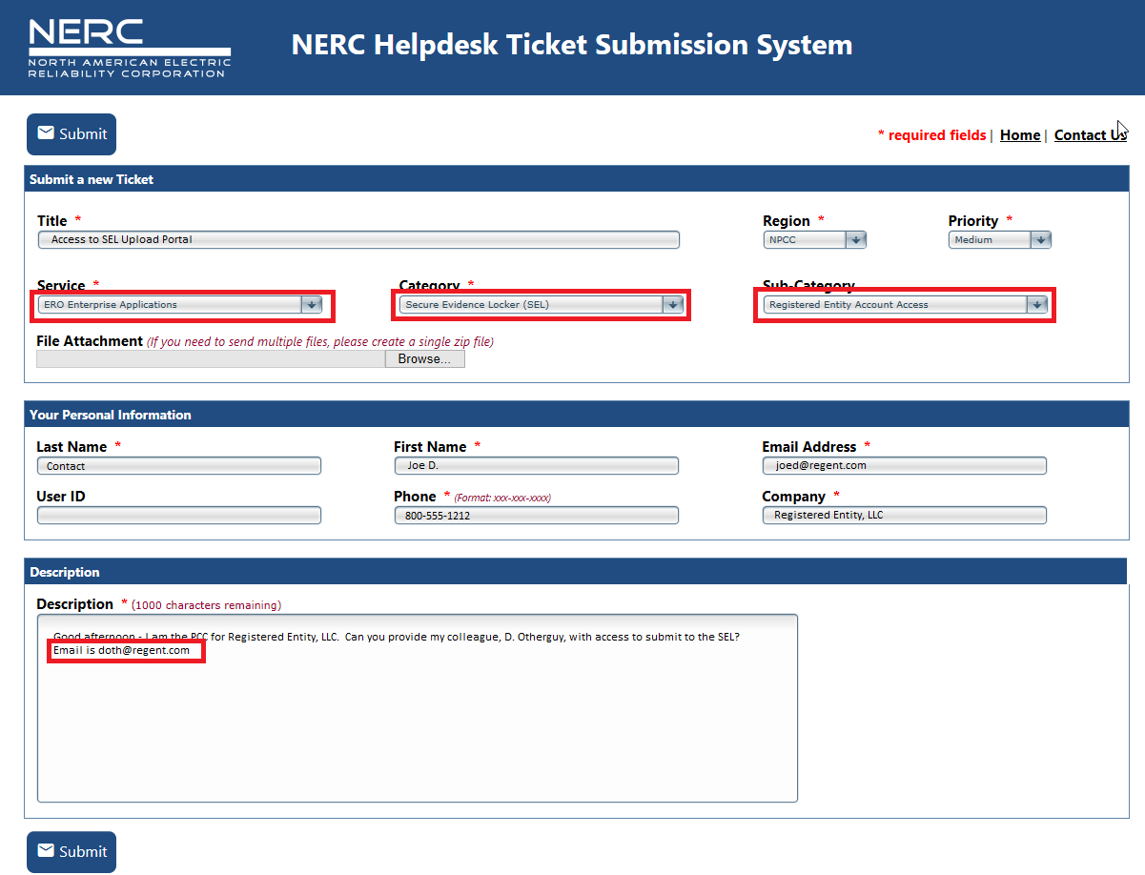
Request SEL Access – Registered Entity
Entity Request SEL Access
User submits an ERO-Enterprise Help Desk Ticket
Region
Their Region
Service
ERO Enterprise Applications
Category
Secure Evidence Locker
Sub-Category
Registered Entity Account Access
Description
The name and email address of the person for whom they are requesting access.

Slide 46
Registered Entity SEL Access Request Review Process
ERO Helpdesk Ticket is routed to the regional contact
Regional Contact replies to ticket with ‘approved’ or ‘rejected’
If approved, the ticket is routed to NERC, and NERC puts user into the SEL Submitter group.

Slide 47
Account Access Revocation
For Day 1 and Day 2, there may be Registered Entity users that need their access to the SEL removed.
A Helpdesk Ticket should be created by the Registered Entity, then approved by the Region and routed to NERC for processing.
Alternatively, a Region may create and forward the Helpdesk Ticket directly to NERC for processing.

Slide 48
Managing Align and all other Application Permissions for your users

Slide 49
Entity Admin Navigates to Manage Permissions
Click the drop down arrow beside My Entity, then select Mange Entity Users:
Option 2:

Slide 50
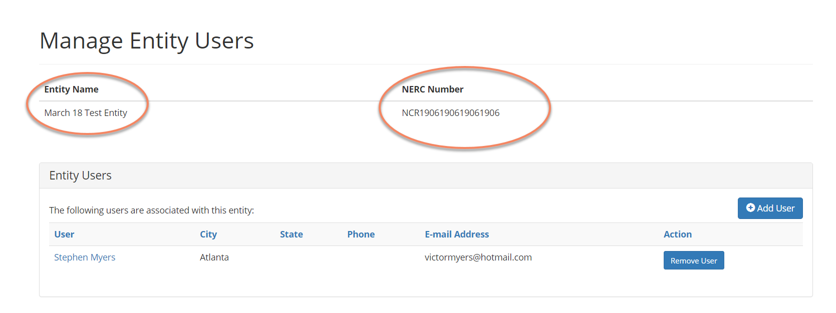
Manage Entity Landing Page
Shows all users that are currently associated with your entity:

Slide 51
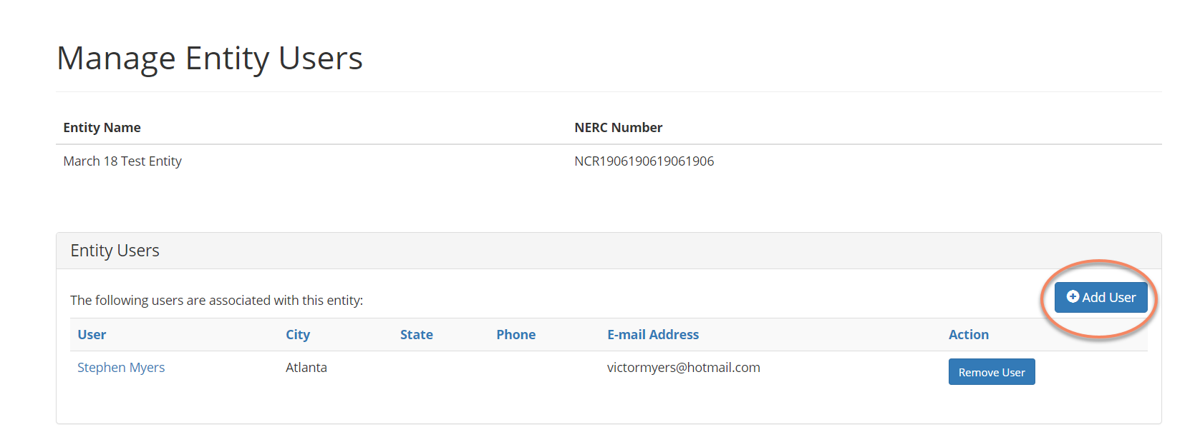
Associating a New User to Your Entity
Click Add User Button circled below:

Slide 52
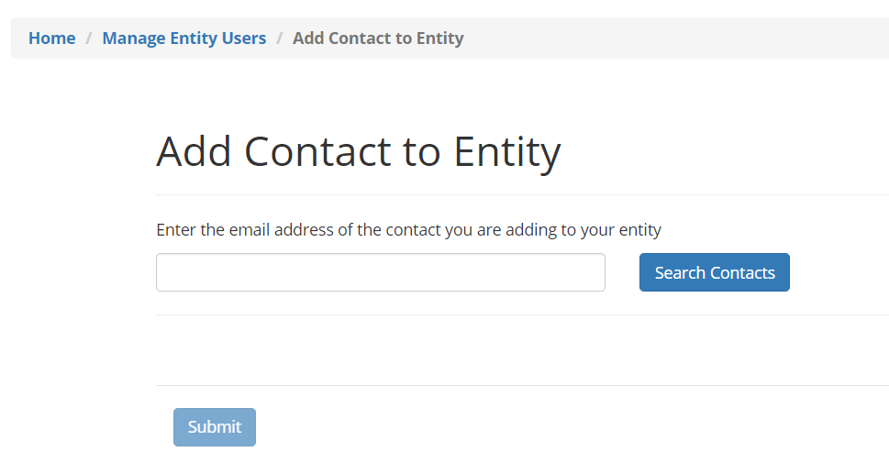
Add User Landing Page

Slide 53
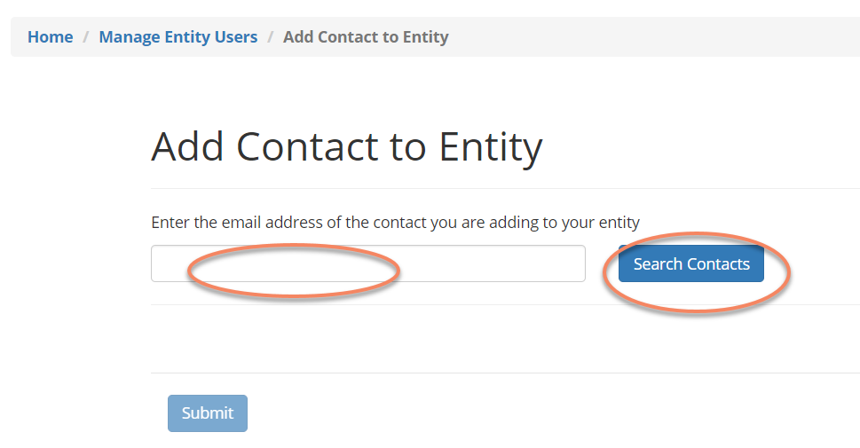
Search for a User
Enter the email address and click Search
If person is found in NERCs database a record will be returned otherwise we don’t a record for that person please instruct the person to create an eroportal account (slides 4-18)

Slide 54
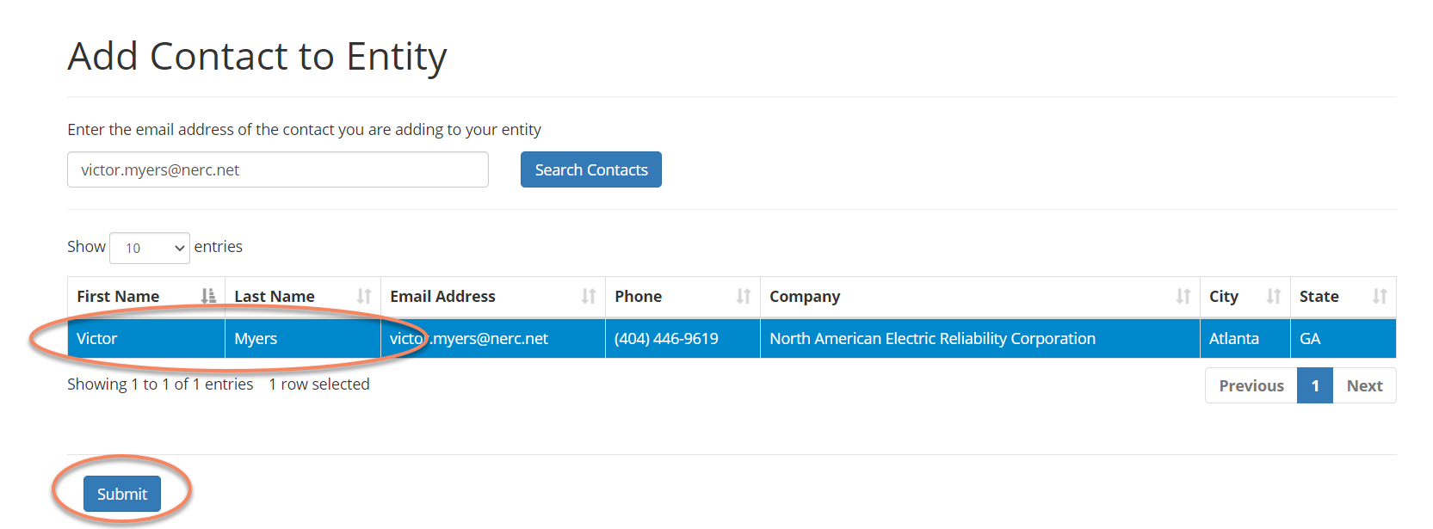
User Found – Add this User
Select the returned record then click the submit button:

Slide 55
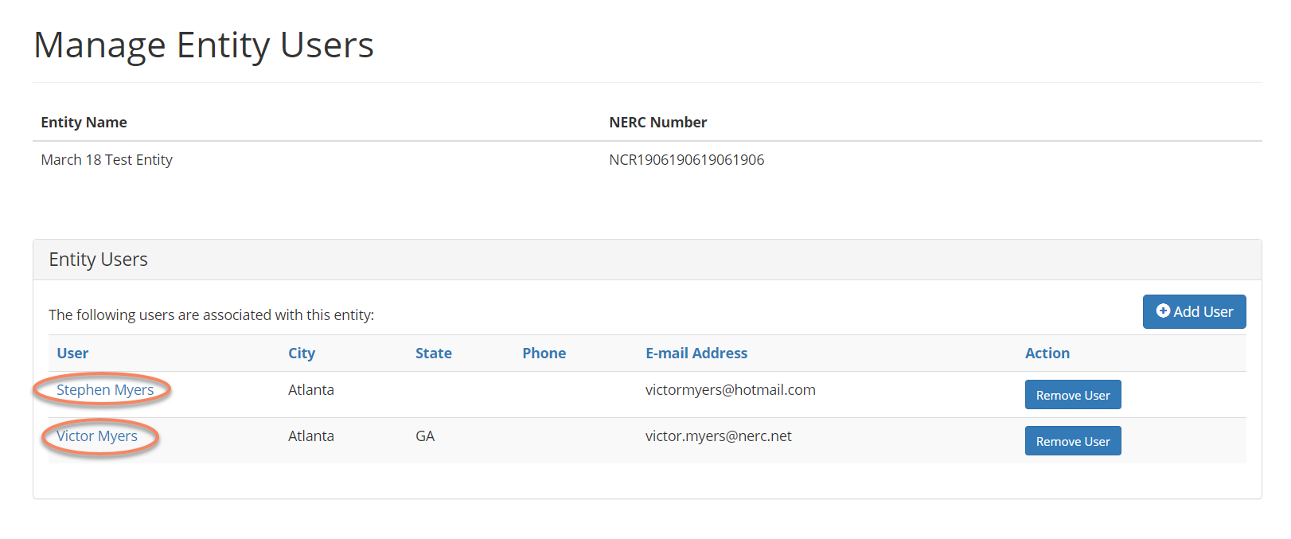
Select User - Managing Permissions
Click the desired user shown below:

Slide 56
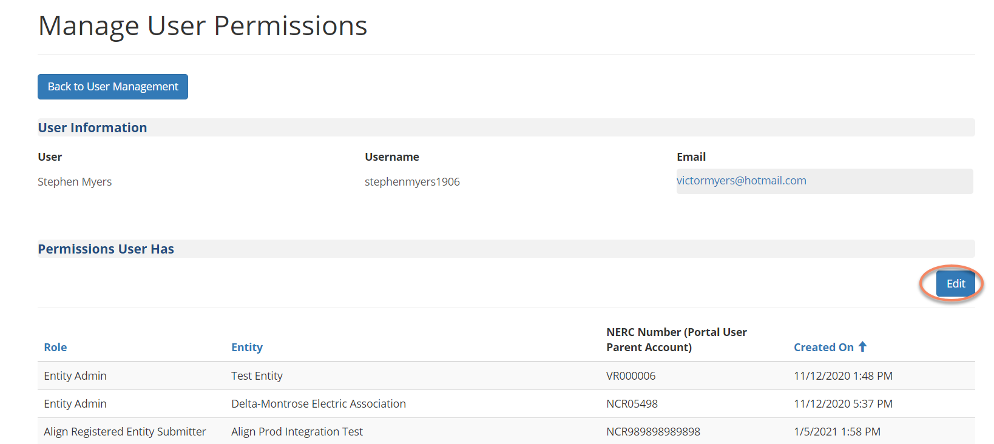
Manage User Permissions
This screen shows you all permissions this user has, click Edit to change:

Slide 57
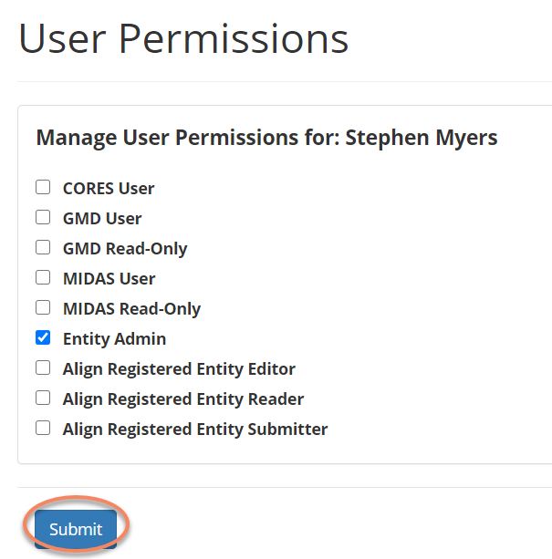
Manage User Permissions continued
Click the box next the permission you wish to add or remove then click Submit to finish:

Slide 58
Align Training Environment Access
Training Environment Access
Align Training URLs:
https://nerc-trn.bwise.net/bwise this url will take you through SSO and you will login with your ERO Portal credentials.
https://nerc-trn.bwise.net/bwise/login this will take you to the Align login where you can use the Test ID’s that were created by Functional Administrator.
Example Test IDs:
NCR99999 Editor 1
WECC Editor 2
ERO Editor 1

Slide 59
Registered Entity SEL Access

Slide 60
Primary Compliance Contacts – Day 1
PCCs will be automatically be assigned access when the system goes live.
Changes following go-live (adding and removing access) will be handled by submitting a Helpdesk Ticket.

Slide 61
Align Submitters – Day 2 (by mid-April)
Registered Entity users that have permission to SUBMIT in Align will be given permission to UPLOAD to the SEL. These permissions will be automatically assigned and removed with Align access.
Other changes (adding and removing access for non-Align users) will be handled by submitting a Helpdesk Ticket.

Slide 62
ERO Portal Users – Day 3 (TBD)
Registered Entity admins will approve SEL access requests similar to how other ERO Enterprise Applications (CORES, GADS Wind) are approved. Any ERO Portal User will be able to request access, subject to approval by their Entity Admin.

Slide 63
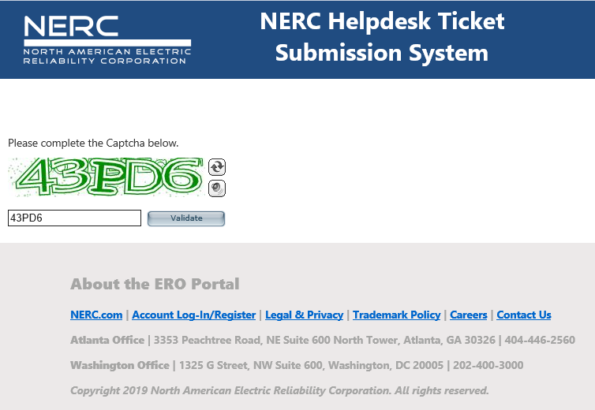
Adding Additional SEL Submitters Day 1/Day 2
Request for additional users to upload via the SEL will be processed as support tickets.
1. Go to the NERC
Support Site
https://support.nerc.net

Slide 64
Adding Additional SEL Submitters Day 1/Day 2
2. Complete a
Helpdesk Ticket
Region
Your Region
Service
ERO Enterprise Applications
Category
Secure Evidence Locker
Sub-Category
Registered Entity Account Access
Description
Indicate the name and email address of the person for whom you are requesting access.

Slide 65
Adding Additional SEL Submitters Day 1/Day 2
3. Submit to your Region
Your region will receive and verify the request. Upon verification, the Region will send the ticket to NERC for processing. Once received by NERC, access requests should be processed within 2 business days.

Slide 66
Removing SEL Submitters
Day1 – Removal of SEL Submitter privileges will be manually addressed by submitting a Helpdesk ticket
Day 2 – For Align users, removal from the Align Submitters group will automatically remove users from the SEL Submitters group. For non-Align users, removal of SEL Submitter privileges will be manually addressed by submitting a Helpdesk ticket.
Day 3 – The ability to upload to the SEL will be managed within the ERO Portal. Adding and removing access will be managed by the registered entity.

Slide 67
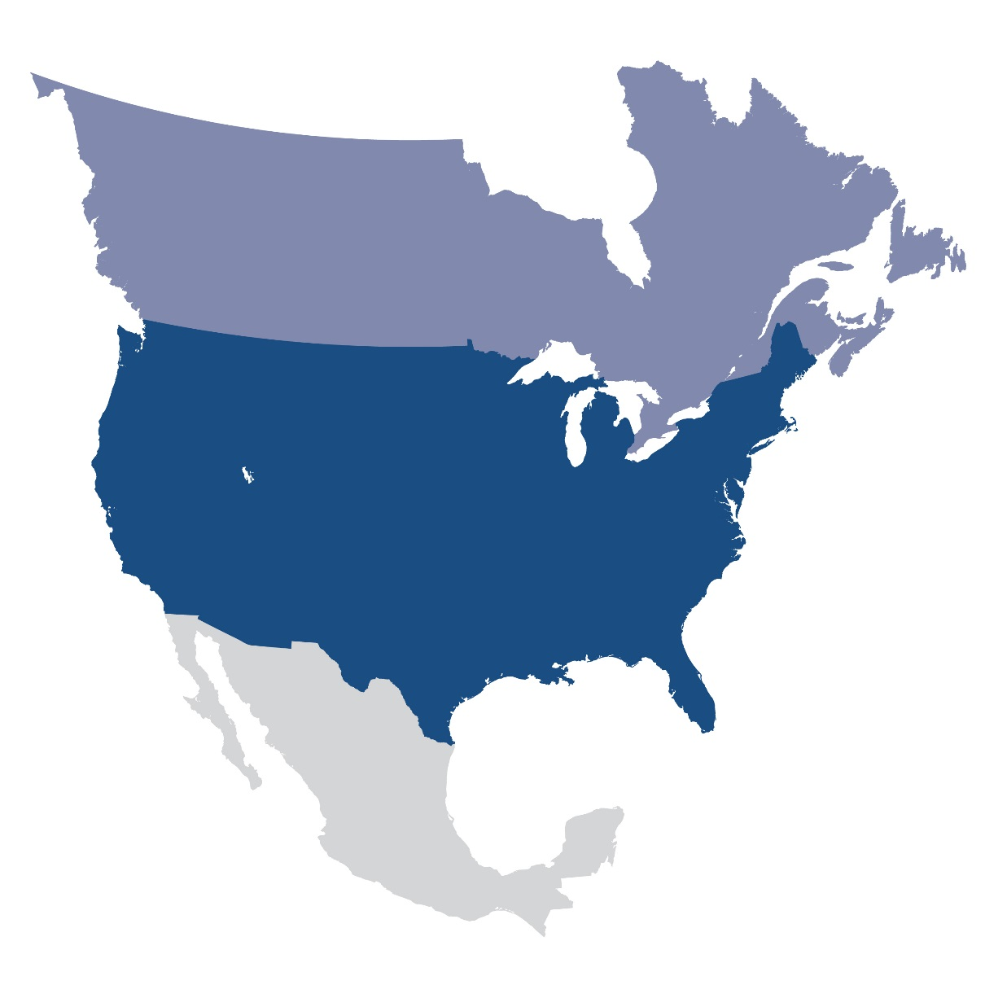
Questions and Answers

